Slide 1
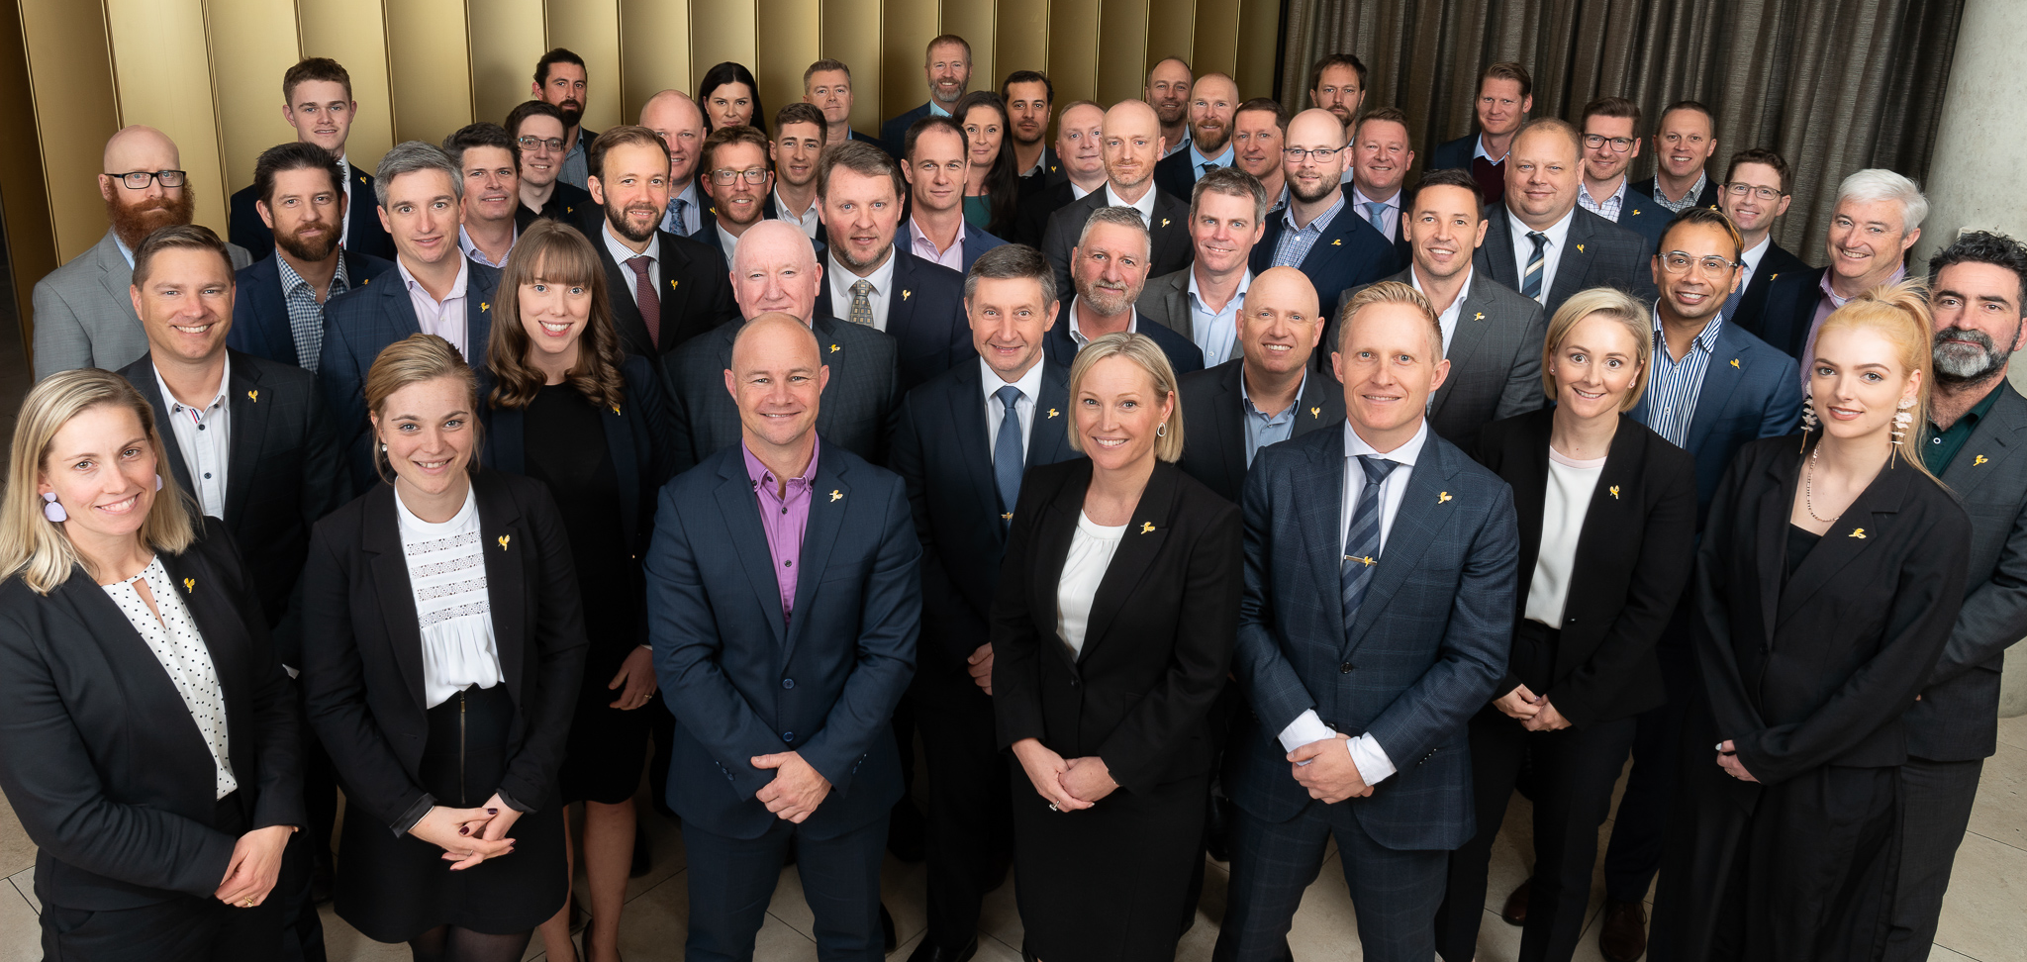
Liability Risk Assessments
“Our Point of Difference is Our People” – Emily Frizell, CEO
AIR & SPACE
MARITIME
LAND
JOINT
E&IG
CIOG

Slide 2
CASG Risk Management
CASG seeks to approach risk in a consistent, collaborative and transparent way
Policy, guidance and tools are available to support effective risk management
Defence framework seeks to actively manage operational, capability and financial risks in procurement
ASDEFCON and Defence Procurement Review 2021 comments
Level of risk acumen within Defence is an issue
Risk allocation is a cause of contention between Defence Industry and Defence
Defence does not accept sufficient share of risk
There should be consistent and detailed engagement by Defence to reduce risk throughout the procurement process

Slide 3
Procurement Risk Management
PGPA requires risk oversight and management for all procurements
CPRs require
Risk management required to support informed decision making (c8.1)
Entities must establish process to identify, analyse, allocate and treat risk when conducting a procurement (c8.2)
General Principle (c8.4) that risk should
Be borne by the party best placed to manage them
Not accept risk which another party is better placed to manage
Not inappropriately transfer risk to the supplier
AAIs require
Considering and engaging with risks to achieve Value for Money (c17)
Actively manage procurement risks (c18f.) proportionate to its scale and scope
Indemnities, guarantees and warranties that create a contingent liability to be approved by a Contingent Liabilities S60 delegate.
Risks should be borne by the party best placed to manage them
Benefits to the Commonwealth should outweigh the risks involved

Slide 4
Conducting Risk Assessments
Risk Assessments are required for all procurements
Evidence of consideration and assessment of risk
Simple Risk Assessment
Project Risk Register
ETP Comment
S23 Comment
Liability Risk Assessment (LRA)

Slide 5
Liability Risk Assessments (LRAs)
LRA is required
If an arrangement contains an indemnity
Prior to agreeing to limit a third party’s (including a contractor’s) liability under a Contract
An LRA
Assesses commercial risk
Relies on SME input to understand the risk impact, mitigations and assessment
Assists Defence understand the risk profile of the procurement
Determines contract liability caps and limits of insurance
Identifies if Contingent Liabilities arise from an indemnity

Slide 6
Contingent Liability
A contingent liability is where the Commonwealth has a liability to pay a third party if certain future event(s) occurs
Legal advice should be sought where an indemnity, guarantee or warranty (collectively known as an indemnity) creates a contingent liability for the Commonwealth
Separate Guidance, including legal advice, is provided for Section 60 LRAs for Foreign Military Sales
A liability cap does not create a contingent liability unless
It involves limiting a suppliers liability to a third party so that the Commonwealth is liable to a third party for any excess above the cap
It limits a supplier’s exposure for damage the supplier has suffered itself, so that the Commonwealth is liable to the supplier for any excess
Section 60 Contingent Liability approval must be obtained prior to or at the time of obtaining S23 approval

Slide 7
LRA Template
9 standard Risks
Template Pre-populated for consistency with respect to standard terms
As with any risk assessment, it is not science and relies on a subjectivity in your assessment
Look at other LRAs completed for similar activities
Use common sense, risks need to be reasonable and credible
Absolute precision is not always possible, apply best estimates
Include assumptions and workings
Tips
Use the Cost Recovery Calculator to help develop estimates (down load link at p33)
Costs in the calculator are approved by Defence Finance Group and updated annually
Project Risk Management Manual (PRMM) is the authoritative guidance

Slide 8
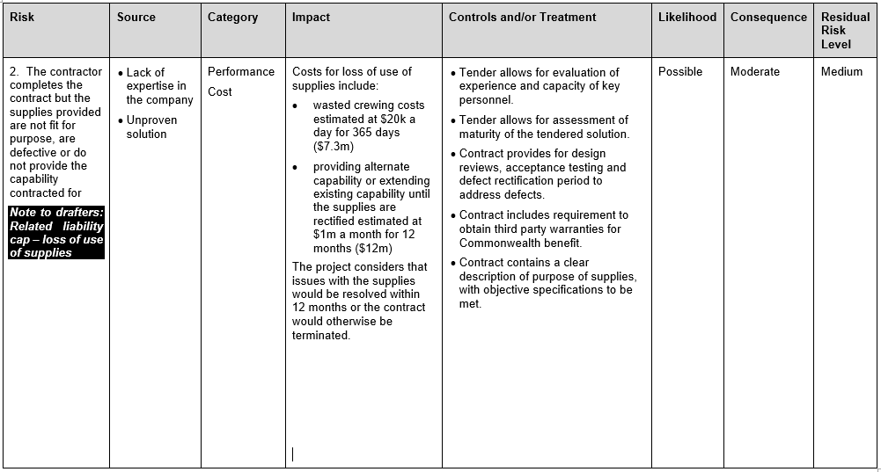
Materiality Assessment (including assessment of Contingent Liabilities)
Maximum Possible Loss Total Liability $575,000 Contingent Liability NIL Most Probable Expenditure Exposure to Defence after applying controls and treatments, the risk exposure Total Liability $500,000 Contingent Liability NIL
------------------------------------------------------------------------
------------------------------------------------------------------------------------------------------------------------------------------------
--------------------------------------------------------------------------------------------------------------------------------------------------------------------------------------------------------------------------------------------------------------------------
Contractor is a mature Defence company with a proven delivery history
Payment schedule is designed to reflect the value delivered to the Commonwealth (ie, not front loaded)
Costs to conduct another approach market $75k (BOE 2 x PO staff and 2 x Contractors for 20 days)
Costs to extend existing capability until the supplies are rectified $500k (BOE 5 months @ $100k per month) = Most Probable
SUMMARY
Maximum Possible Loss $575,000 = Table 2
Most Probable Expenditure $500,000 = Adjustments to Table 2 values
Contingent Liability Requiring S60 Approval = NIL

Slide 9
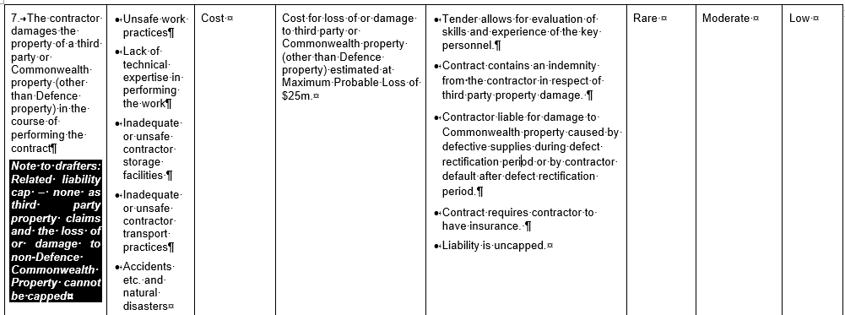
Materiality Assessment (including assessment of Contingent Liabilities)
Maximum Possible Loss Total Liability $250,000 Contingent Liability $250,000 Most Probable Expenditure Exposure to Defence after applying controls and treatments, the risk exposure Total Liability $250,000 Contingent Liability $250,000
------------------------------------------------------------------------
--------
Damage caused to third party property during earthmoving (Est $250k) = Most Probable = Contingent Liability
SUMMARY
Maximum Possible Loss $250,000 = Table 2
Most Probable Expenditure $250,000 = No adjustment to Table 2
Contingent Liability Requiring S60 Approval = $250,000

Slide 10
LRA Reviews
LRAs are required to be
Developed early, normally as part of the Procurement Planning phase
Reviewed prior to contract negotiation
Updated following contract negotiation and prior to contract finalisation
Approved prior to obtaining S60 Contingent Liability approval (if applicable)
Approved prior to obtaining S23 commitment approval
Reviewed and updated across the Contract lifecycle
Best practice is to review and, if applicable, update the LRA for each contact change proposal (CCP)

Slide 11
Further Information
Procurement and Contracting Liability Risk Management website
Department of Finance RMG414 Resource Management Guide 414: Indemnities, guarantees or warranties
Section 60 LRAs for Foreign Military Sales

